Slide 1


Optimized Median Search in Two Sorted Arrays
This presentation explores an optimized approach to finding the median in two sorted arrays using the divide-and-conquer strategy. The algorithm efficiently partitions the arrays, identifies a median, and recursively searches for the true median. It provides a solution with improved time complexity compared to brute-force methods.

Slide 2


Divide and Conquer Approach
1
Divide
Divide the two sorted arrays into halves. This creates four subarrays, representing the left and right portions of each original array.
2
Conquer
Recursively search for the median within these subarrays. This involves comparing the middle elements of the subarrays to identify potential median candidates.
3
Combine
Once the median is found in the subarrays, combine the results to determine the overall median for the original two sorted arrays.

Slide 3

Edge Cases and Handling Odd/Even Array Lengths
Scenario
Array Lengths
Median Handling
Odd-Odd
Both arrays have odd lengths
The median is the average of the two middle elements.
Even-Even
Both arrays have even lengths
The median is the average of the two middle elements.
Odd-Even
One array has odd length, the other has even length
The median is the middle element of the array with odd length.

Slide 4
Partitioning the Arrays
Array 1
Array 2
Subarrays
The first sorted array is partitioned into two subarrays, with the middle element as the dividing point.
The second sorted array is similarly partitioned, ensuring that the subarrays have equal lengths or the left subarray of Array 2 has one more element than the right subarray.
This division creates four subarrays: left-1, right-1, left-2, and right-2. Each subarray represents a distinct portion of the original arrays.

Slide 5
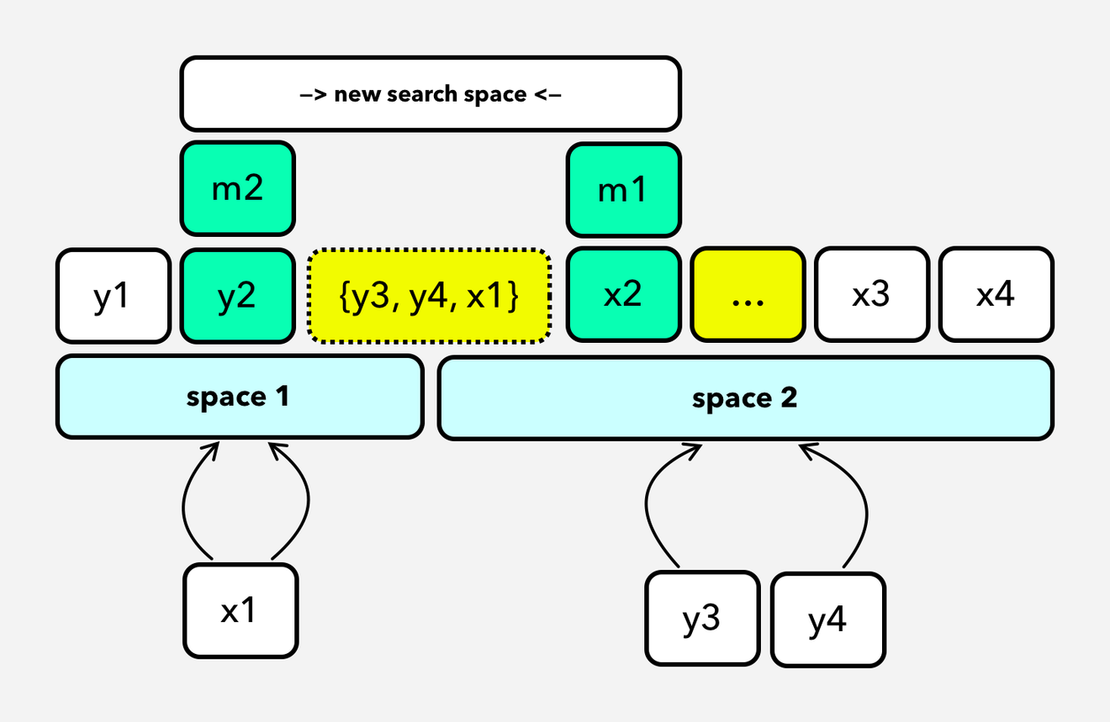
Two Search Spaces: Arrays are divided into two parts, "space 1" and "space 2," with elements like y1, y2, ... and x1, x2, ....
Middle Elements (m1, m2): The middle elements of both arrays (m1 for space 2 and m2 for space 1) are used to partition the arrays.
Comparison & Elimination:
Compare m1 and m2. If m2 < m1, elements smaller than m2 in space 1 and larger than m1 in space 2 are eliminated.
This reduces the search space for the median.
Recursive Partitioning: The search space is repeatedly divided, narrowing down potential candidates for the median.
Final Median: The candidates for the median (highlighted in yellow) are reduced to a small subset, allowing the median to be found efficiently.

Slide 6
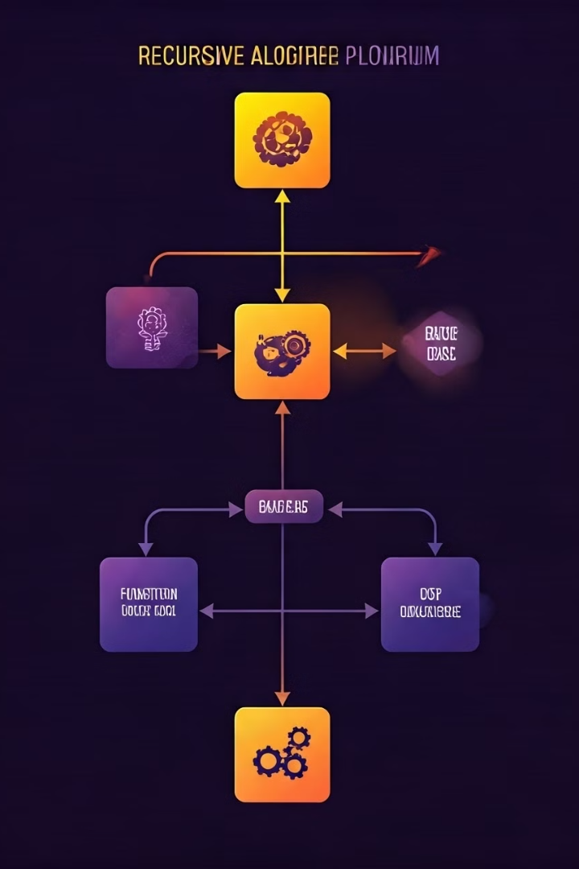





Recursive Median Search
Base Case
If the lengths of the subarrays are 1 or 0, the median is directly identified.
Recursive Call
The function recursively calls itself with the appropriate subarrays, narrowing down the search for the median.
Median Refinement
Based on the comparison of middle elements and the lengths of the subarrays, the median candidate is refined.
Return Median
Finally, the true median is returned after multiple recursive calls, converging to the optimal solution.

Slide 7


Time Complexity Analysis
Logarithmic Complexity
Efficient Search
The algorithm has a time complexity of O(log n), where n is the combined length of the two arrays.
The divide-and-conquer approach effectively reduces the search space, leading to a significant performance improvement compared to linear time algorithms.
Scalability
The logarithmic complexity ensures that the algorithm scales well for larger input sizes, making it suitable for handling large data sets.

Slide 8
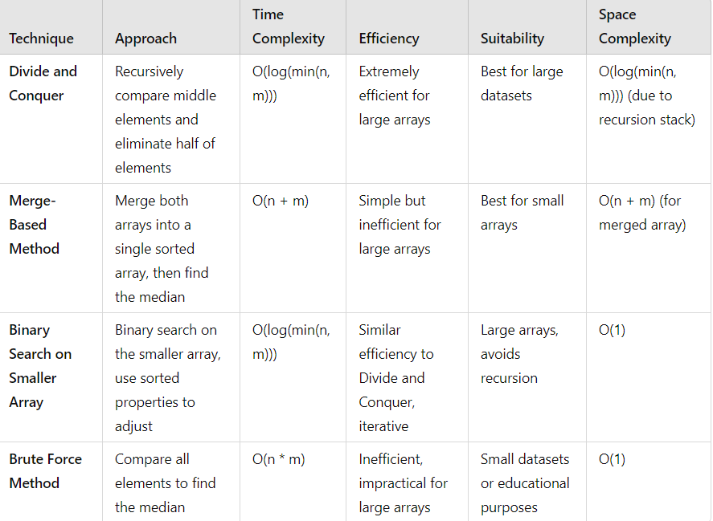


Slide 9






Conclusion and Key Takeaways
Optimized Efficiency
Handling Edge Cases
The divide-and-conquer approach significantly improves time complexity, making the algorithm more efficient for larger arrays.
The algorithm effectively handles edge cases related to odd and even array lengths, ensuring accuracy and robustness.
Recursive Strategy
Practical Applications
The recursive strategy elegantly breaks down the problem into smaller subproblems, facilitating a structured and efficient solution.
This algorithm has practical applications in data analysis, database management, and other areas where finding medians in sorted data is crucial.

Slide 10


